Slide 1
Fake News Detection Project
Idan Leibovitch
Evgenia Samsonov
Chanan Zevin

Slide 2
Mission statement
Probelm
With the fast news streaming between all social networks and to online news websites, where the competition is measuring who will get it faster and better. Naturally fake news was a by-product of that situation and by other factors (such as political interests etc).
Goal
Create an automatic tool that will classify every new item if it’s a True/False news

Slide 3
Overview
1
2
3
EDA
Data preparation
Data understanding
Cleaning, fixing, exploring and getting the initial insights
fit models, normalize, stemming and change text to numeric
4
5
6
Models testing
Select the winning model
Conclusions & insights
testing types of modeling and analyze the results

Slide 4
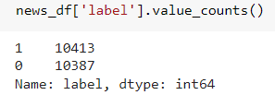
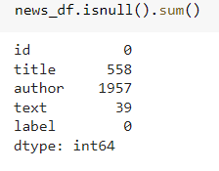
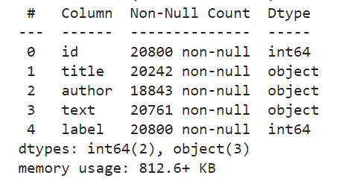
Data understanding
Data source
Balanced
The dataset is a mixed articles pulled from US based websites. (Kaggle)
Dataset is balanced :
Size
Shape of News data : (20800, 5)
Null values:
Columns
Columns type:
Columns: (['id', 'title', 'author', 'text', 'label']
'label’ : 1 - unreliable (fake)
0 - reliable (true)

Slide 5
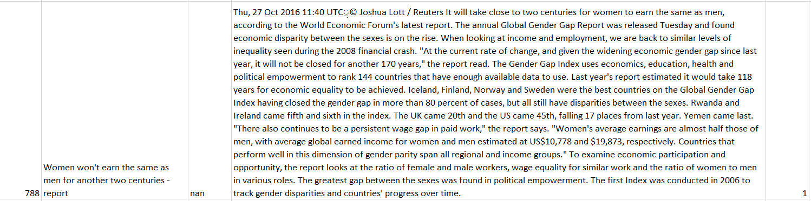
Data understanding
Text examples: can you guess if it is a fake or true?

Slide 6
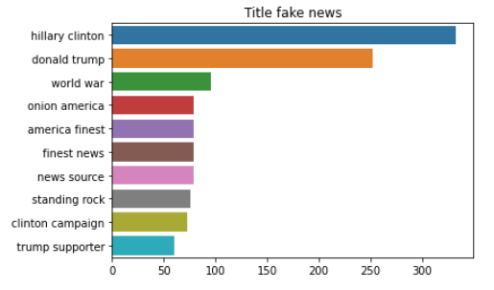
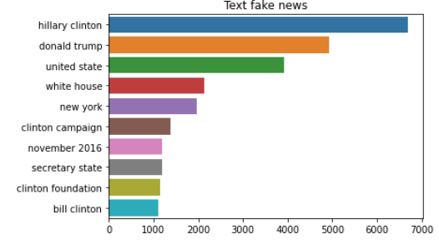
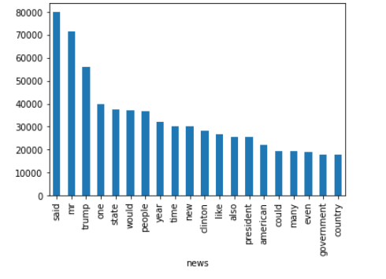
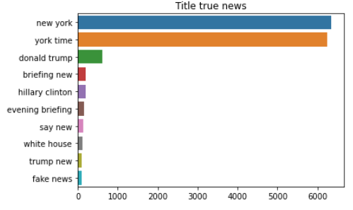
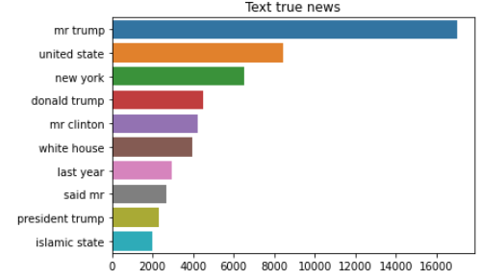
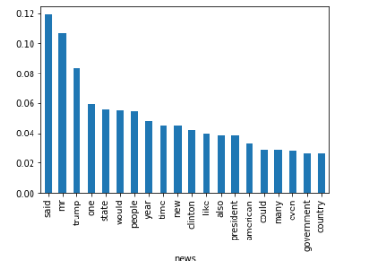
EDA
Most frequent words by labels
Top 20 words in the text:

Slide 7
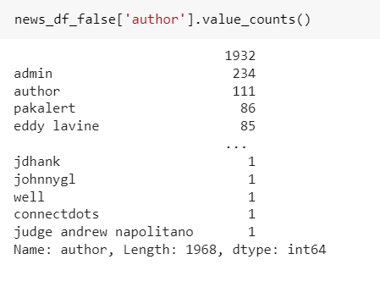
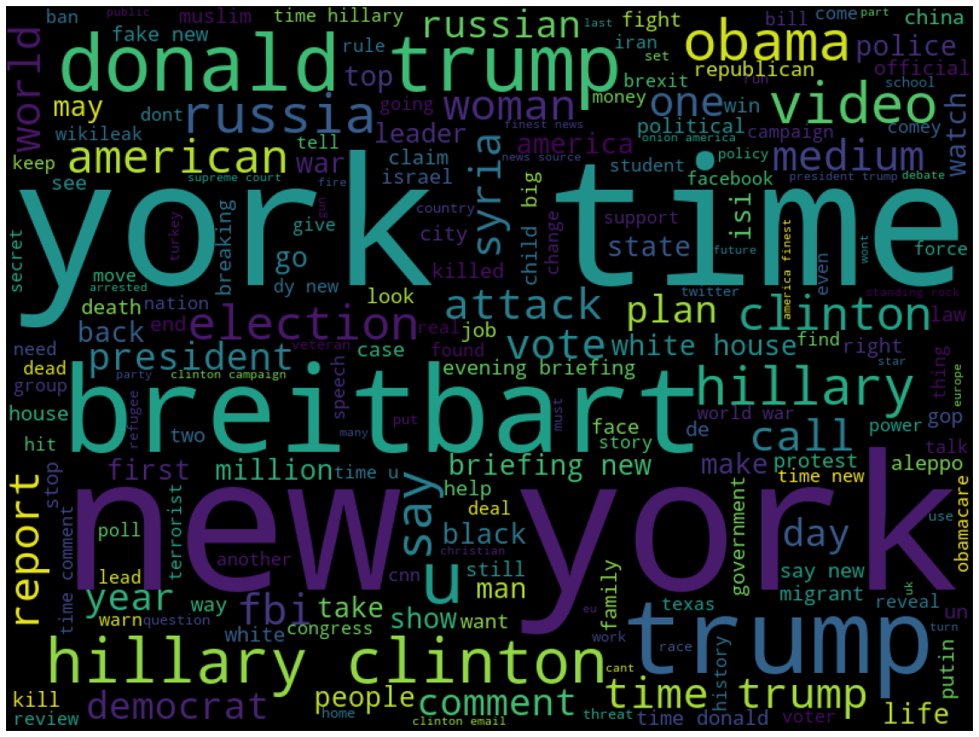
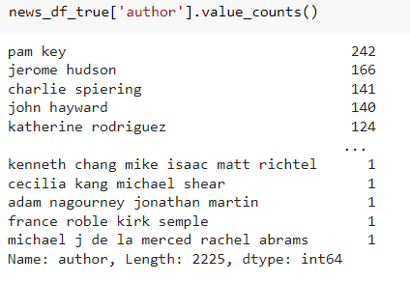
EDA
Authors by label comparison:
Another display for frequent words:

Slide 8

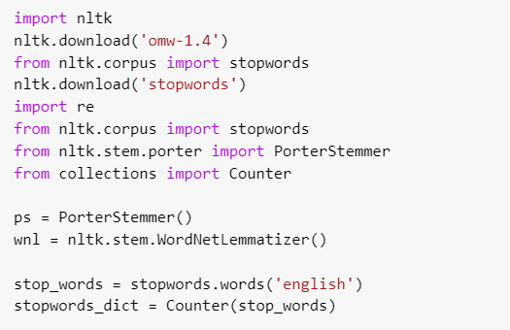
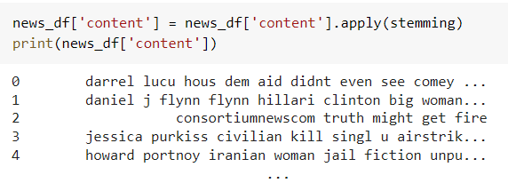
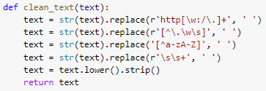
Data preparation
Content Model
Stop Words dealing
Merging author and title to one column
most commonly used in any language such as “the”,” a”,” an” etc.
Stemming
process of reducing a word to its Root word, example: actor ->actress, acting --> act
Cleaning text from unused characters

Slide 9

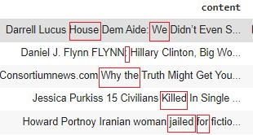

Data preparation
Punctuation dealing
!"#$%&\'()*+,-./:;<=>?@[\\]^_`{|}~
Data before preparation
Data after preparation

Slide 10

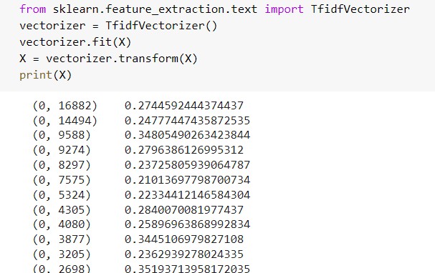
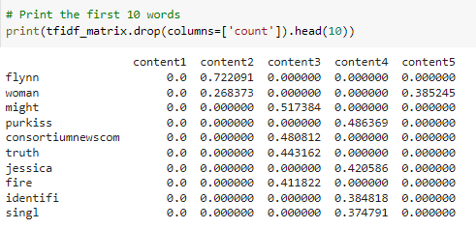
Data preparation
TF-IDF
TF = (Frequency of a word in the document) / (Total number of words in the document)
IDF = log(total number of documents / number of documents including the word)
numerical statistic which measures the importance of the word in a document

Slide 11
Models testing
Classification models
Logistic regression, Decision tree, KNN, Multinomial Naive Bayes
Models tested
Sequence model
LSTM

Slide 12






Models testing
(Merging author and title to one column)
Comparing classification models results
Results for unprepared data
Results for prepared data
Data frame unchanged (original data including punctuation marks, original text, large/small letters, etc.)
Data frame with all preparation (punctuation, stemming, cleaning characters, stop words)

Slide 13



Models testing on full dataframe (title,author and text news)
Comparing classification models results
Results for unprepared data
Example for unprepared data:

Slide 14
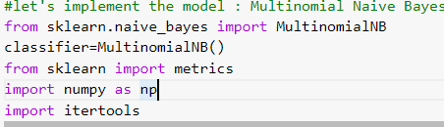
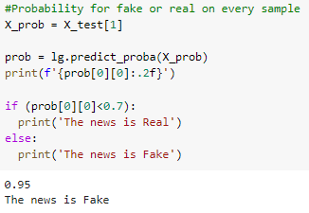
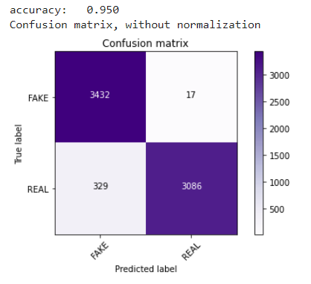
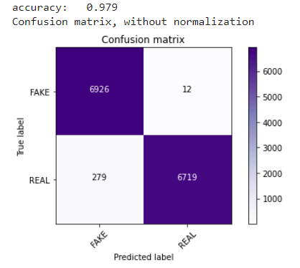

Models testing
Multinomial Naive Bayes
Multinomial Naive Bayes algorithm is a probabilistic learning method that is mostly used in Natural Language Processing (NLP)

Slide 15
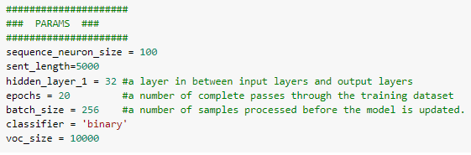
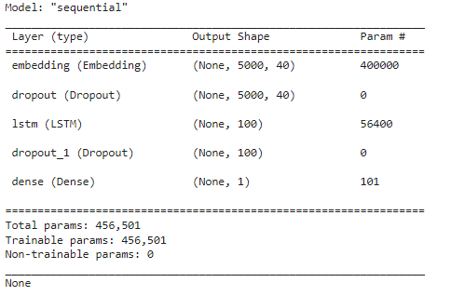
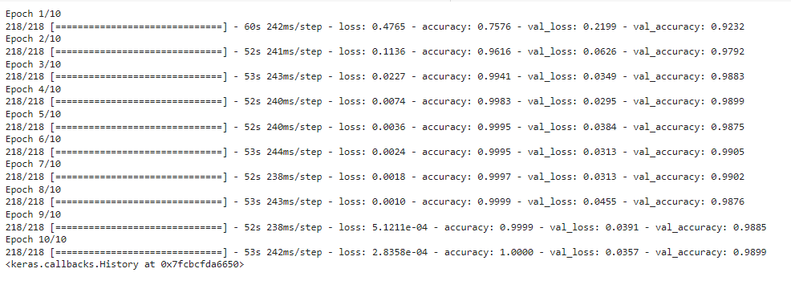
Models testing
LSTM Model
Sequential model with 1 LSTM layer of 100 neurons on content_features df
LSTMs controls the memorizing process, quite effective in predicting the long sequences of data. Information in LSTMs can be stored, written, or read via gates that open and close. In simple words - the model makes decisions if to save of forget the input and based on that create the right connection. We input each word, words relate to each other in some ways.
We make predictions at the end of the title/author/text when we see all the words in that article.
Running 10 epochs

Slide 16

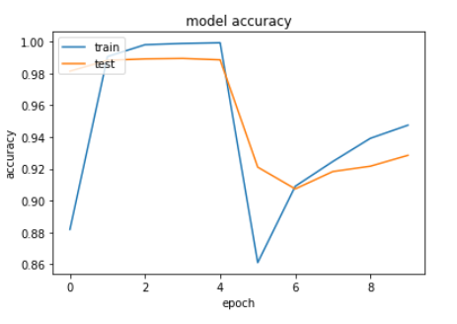
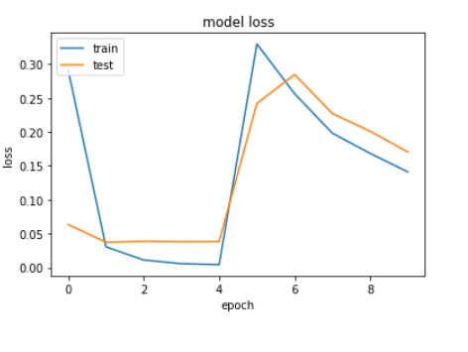
Models testing
LSTM Model
Optimal accuracy and loss were achieved with epoch 4
Check accuracy on test data:

Slide 17
Conclusions & Insights
1
2
3
4
Data cleaning
Validation
Winning model
Future plans
By the data given there is no necessary in stemming, removing punctuations etc since the results are good even without cleaning process. Looking for red flags such as the autor or extreme words could assist.
There are 2 types of validation in this project: our tool (work) and the source credibility. For validate our tool we need the lowest loss (log loss, RMSE) and for credibility we need to use likelihood.
There is no significant winning model, though Logistic regression was the one with high accuracy, lower log loss and yet less overfitted.
Pipeline for any data should include the “fast” version first and multiple models testing, considering the loss is to test our tool and accuracy for testing the source credibility

Slide 18
Thank you

